Slide 1
CSE 461
Midterm Review

Slide 2
Help yourself to snacks

Slide 3
Midterm overview
50 minutes
Closed book, closed notes
Covers topics in lectures, projects and homeworks
Not intended to test things you can easily look up
If something seems like you could Google it in a second, ask JZ
Mixture of straightforward questions and conceptual thought questions
Bonus Question: name all three TAs for CSE 461
Keith, Patrick, and Nat

Slide 4
Network Layers & Encapsulation
Application
Application
Transport
Transport
Network
Network
Data Link/ Physical
Data Link/ Physical

Slide 5
Application Layer
Application
Application
Used by applications
Protocol is arbitrary

Slide 6
Transport Layer
Transport
Transport
Involves packaging of data for transport
UDP/TCP and ports

Slide 7
Network Layers & Encapsulation
Network
Network
Handles issues related to routing on the network
Data treated as packets

Slide 8
Data link/Physical Layers
Data Link/ Physical
Data Link/ Physical
Data link layer
Puts data onto the actual line
Error-correcting codes to account for line noise are in the data link layer
At this level, data consists of frames
Physical layer
Actual electrical or wireless oscillations

Slide 9
Addressing
MAC addresses
IP addresses
Ports
Sockets

Slide 10
MAC Addresses
48-bit
Identify instance of specific network interface hardware
Bonus Question : can you guess what device 40:f4:07:a0:21:07 is?
Nintendo Wii U NIC (40:f4:07 belongs to Nintendo)

Slide 11
IP addresses
32-bit (in IPv4) or 128-bit (in IPv6)
Identify a host on a network
Can change dynamically
Bonus Question : do you know what 8.8.8.8 is?
Google DNS IP address (8.8.8.0-8.8.8.255 belongs to Google)

Slide 12
Ports
16-bit
Identify communication channels on a specific host
Often map to applications
Bonus Question : what application uses port 1214?
Kazaa

Slide 13
sockets
Programming interface for networking
Most common implementation is Berkeley sockets
Allows data to be sent with file descriptor-like structures
Bonus Question : name two valid type arguments you can specify for a socket
SOCK_STREAM, SOCK_DGRAM, SOCK_SEQPACKET, SOCK_RAW

Slide 14
Udp vs. tcp
UDP | TCP
Unreliable | Reliable
Connection-less | Connection-oriented
No acknowledgements | Acknowledgements
No flow control | Sliding window
No sequence numbers | Sequence numbers
UDP

Slide 15
metrics
Bandwidth
Latency
Throughput, goodput
Channel utilization
Shannon’s theorem
Nyquist rate

Slide 16
FREQUENCY & bandwidth
Frequency: rate of an oscillation
Bandwidth: measures the width of a range of frequencies
Bandwidth = freq_{upper} - freq_{lower}
Human hearing bandwidth: ~20kHz (20kHz - 20 Hz)
“Bandwidth” and “bitrate” are often used interchangeably; this is a different definition
Bonus Question: what’s the frequency range and bandwidth of 802.11 b/g?
2.4 GHz to 2.5 GHz; 100 MHz

Slide 17
latency
Time between source and destination
Shortest possible latency bounded by c
Ping can measure round-trip latency
Why might latency vary between ping tests?
Bonus Question: what’s the round-trip time to Voyager 1, at 19 billion km from Earth? Light speed is 300,000 km/s.
126,666 s, or just over 35 hours

Slide 18
Throughput & goodput
Throughput: measures how much data can be sent in a given time period
E.g., 100 Gbps
Goodput: excludes protocol bits and retransmitted data packets
What factors might cause goodput < throughput?
Protocol overhead
Dropped or corrupted packets
Flow control

Slide 19
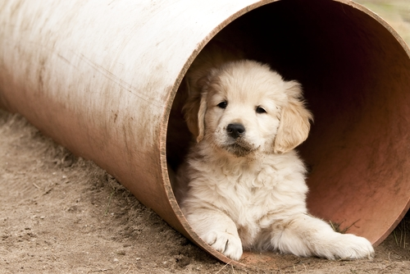
Channel utilization
Calculates how much of the channel is being used
Bandwidth-delay product = throughput * latency
Kind of like: Volume of a pipe = area * length
Channel utilization = (data in flight at any given time) / (bandwidth-delay product)
If you’re using stop-and-wait and only sending 1KB at a time over a 1MBps channel with latency of 10s, what’s the channel utilization?
1 / (1024 * 10) = ~0.01%

Slide 20
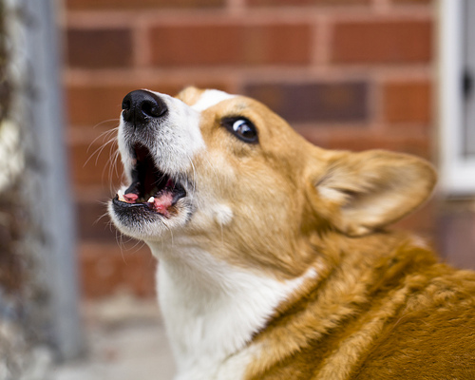
Shannon theorem
Tells about maximum bitrate in the presence of noise
Capacity = bandwidth * log₂(1 + signal/noise)
C = B log₂(1 + S/N)
What are the implications of this?

Slide 21
Nyquist RATE
To recover a waveform, the sampling rate must be at least two times the highest frequency
Telephone sampling rate is 8kHz; what are the implications of this?
What sampling rate would be required to recover all frequencies audible by humans? (Up to 20kHZ)
Audio CDs use 44.1kHz sampling rates for this reason

Slide 22
Network-related Story time
“At this point the only solution that might work would be to create a different thread and initialize the network on that thread, still this will take us a significant amount of time and significant resources... We’re afraid that the thread creation will also have a blocking impact and also the network initialization will take even longer to complete…”

Slide 23
Http
HTTP 1.0
Initial connection over TCP acts as a preamble
Content-length can designate payload end
Bad for streaming
Alternative: drop the connection!
Caching used heavily
HTTP 1.1
Data comes as a stream, chunked into defined lengths
Connections are reused, reducing overhead
Some pipelining possible, but limited (HOL blocking)
HTTP 2.0
Reduces latency through compression
Allows asynchronous sending/multiplexing

Slide 24
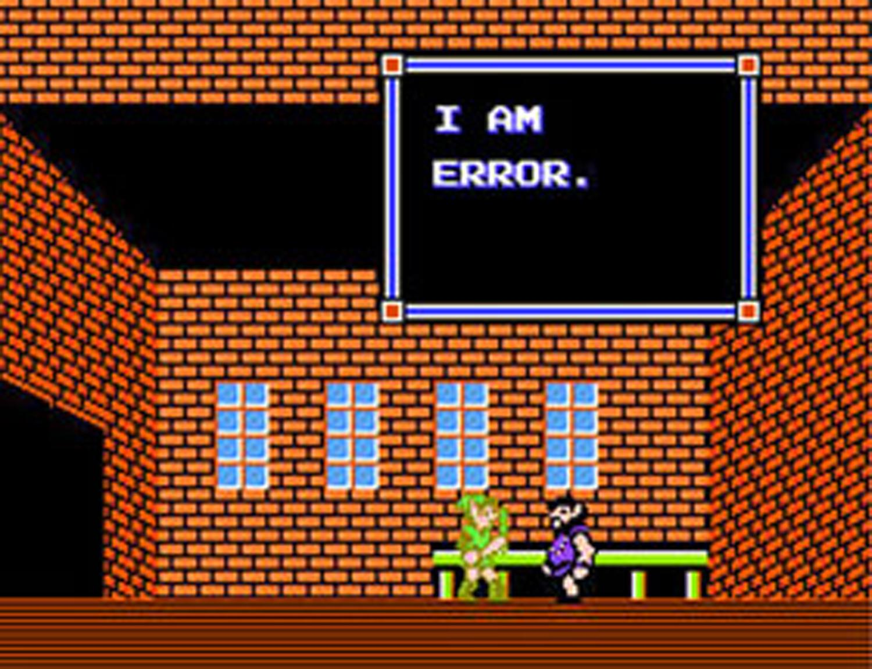
Error Handling
Parity bits
Hamming codes
Checksums
CRCs
Bursty errors and error locality
MITM attacks
Cryptographic hashing
Digital signatures

Slide 25
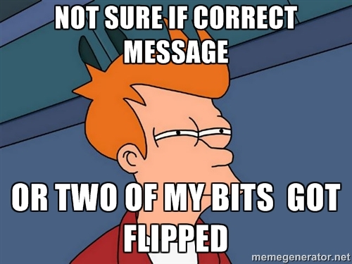
Parity bits
Bits check parity on a set of bits
Even parity: bits add to 0
Odd parity: bits add to 1
Multiple parity bits (on odd bits/ on even bits, etc.) can increase effectiveness
What parity bit would need to go in the x to achieve even parity?
0010101x

Slide 26
Hamming codes
An extension of bit parity, where parity check bits are in “powers of two” positions
Bit string: 0 0 1 0 0 0 0 1 0 0 1 Bit number: 1 2 3 4 5 6 7 8 9 10 11 Par/msg: p p m p m m m p m m m
Each data bit is checked (with even parity) by check bits that make up its “power of two” sum
E.g., for data bit 7, add to sum for parity bits 4 + 2 + 1
Possible to recover from single errors by reading check bits in reverse order and putting a 1 for each bit that is incorrect (this is the “error syndrome”)
Hamming distance: minimum number of bit flips necessary to change one string into another

Slide 27
checksums
Several algorithms:
One studied in class added all words in data as unsigned numbers, allowing to overflow
Sum was then compared to check data integrity
What are the possible problems with this? How many bit flips does it take to break it?
Susceptible to lots of different types of bitflip errors
Only takes 2

Slide 28
crcs
Like a checksum, but better
Somewhat complex polynomial algorithm
Good for detecting bursty errors

Slide 29
Super-basic security
Man-in-the-middle attacks
Cryptographic hashing
Very, very hard to reverse
Digital signatures
Public/private key encryption

Slide 30
Other Topics
End-to-end argument
Packet ordering and flow control shouldn’t be done by the network; it’s wasted work
What’s the counterargument?
Sliding window protocol
Receiver must receive a certain minimum number of segments before sender can send new data
Used in TCP
Cumulative ACKing
ACKing a sequence number means you’ve received all data preceding that sequence number

Slide 31
Project 1 questions
Could you use cumulative ACKs without breaking the protocol? Would it be useful?
Why use headers?
Why does the registration server need to be idempotent?
Idempotent: can be applied multiple times without changing the result beyond the initial application

Slide 32
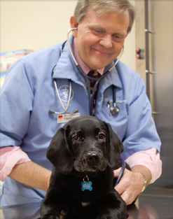
Sample exam questions

Slide 33
Sample question
Ethernet and 802.11 both support multiple data rates. When an Ethernet cable is plugged into the device, it communicates with the other end, chooses a rate to use, and then sticks with it. 802.11 devices, however, continuously talk to the AP to choose a specific rate to use for the next short while, adjusting that rate up and down as they please.
Why is it a good idea for 802.11 to repeatedly choose transmission rates? Why is it not a good idea for Ethernet to do this? (Discuss with someone near you.)

Slide 34
Answer
The 802.11 signal-to-noise ratio can change dramatically over time, which strongly affects the possible transmission rates. Unless 802.11 adapted, it would have to choose between wide coverage at low rates and high rates at low coverage. Dynamic adaptation lets it try to achieve both. Ethernet operates in a much more constrained environment, with strict limits on signal quality imposed by the specification. The environment does not change dynamically.

Slide 35
Sample question
A sender and receiver are using the sliding window protocol, with cumulative ACKs. The receiver has a bug where it repeats the last ACK it sent whenever it hasn’t received a data frame in the last 10 msec. The connection is bad enough that some data and ACK frames may be lost. Will the sender and receiver achieve reliable transmission? Will this protocol fail? ? (Discuss with someone near you.)

Slide 36
Answer
They’ll achieve reliable transmission, assuming no bugs other than those described. The extra ACKs will simply repeat a previously sent ACK. They won’t affect the sender’s window; the sender will view them as duplicate ACKs and drop them.

Slide 37
Sample question
In Project 1 your code sent UDP packets from a client to a server. If we were to look at the bits actually being carried on the wire (assuming we're using a wired network), we'd find the destination IP address and port were part of the bits being sent. Did the bits on the wire also carry a destination MAC address, or not?

Slide 38
Answer
Yes. All data delivery happens at the link layer, which uses MAC addresses. Higher level protocols, like UDP, are encapsulated in link layer frames.

Slide 39
Sample question
Sliding window protocols specify a sending window and a receiving window. Can it ever be useful for the sending window to be larger than the receiving window? Briefly explain your answer.

Slide 40
Answer
Yes, possibly. The sending window limits the amount of data that can be in flight but unacknowledged. The receiver window is a limit on the memory available for buffering and reordering. If the receiver is capable of consuming each incoming frame basically as it arrives, it could have a very small receive window. In that case, the send window could be larger than the receive, to allow frames to be in flight (on the wire).

Slide 41
Additional study suggestions
Read through your project 0 & 1 code and diagram what it’s doing
Review HW problems; do similar problems
Watch David Wetherall’s Coursera course videos
Review old midterms
Available on CSE site (but cover somewhat different material than what ours will)

Slide 42
Any questions?

